Slide 1
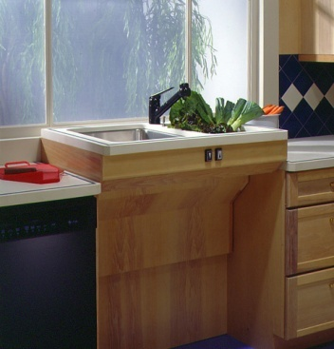
TOP DESIGN IDEAS FOR AGING-IN PLACE - A PHOTOGRAPHIC STUDY BRIDGES CONFERENCE - 2018
Attractive Ideas for Easy Living
By Dan Bawden, CAPS
Legal Eagle Contractors Co.
Houston, Texas

Slide 2
A LITTLE BIT ABOUT ME…

Slide 3
89% Of Americans Over 65 Want to Age in Place

Slide 4
You Might Be Surprised to Learn That…
Aging in Place & universal Design:
Can allow you to stay in your home much longer than you expected
Create age-friendly charm wrapped in out-of-sight conveniences
Provide safety in the home, especially in fall-prevention
Can actually add re-sale value to your home
Costs way less than 1 year in an assisted living facility
Is good for everyone in the family!

Slide 5
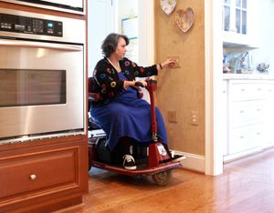
What is “Grand-Design”?
Ideas to make your home safer and more attractive – with features that are usable by all of your family members…
From Grand-KIDS
to
Grand-PARENTS!

Slide 6
What does “CAPS” stand for?
“CERTIFIED AGING IN PLACE SPECIALIST”
+/- 7000 Graduates in the US & Canada have earned the Certification so far
Three full days of classes, with exams
Taught at the Greater Houston Builders Association Education Center Beltway 8
Costs about $600 for all 3 classes
Graduates listed by state on AARP website

Slide 7
Benefits of Choosing a “CAPS–Trained” Contractor.
There are contractors in Houston that specialize in Home Modifications for seniors and those with challenges.
AARP is our partner in this program
CAPS-Certified contractors know how to assess how well your home works for you, and recommend attractive changes.

Slide 8
INTERESTING STATS
40% of adults age 85+ live alone
33% of adults age 65+ live alone
20% of US population lives with one or more disabilities (56.7 million)
10% of US adults are caring for and adult or child with serious health issues
Courtesy of Ortman, et al.

Slide 9
READY FOR A SLIDE SHOW?
Let’s look at some home design ideas!

Slide 10
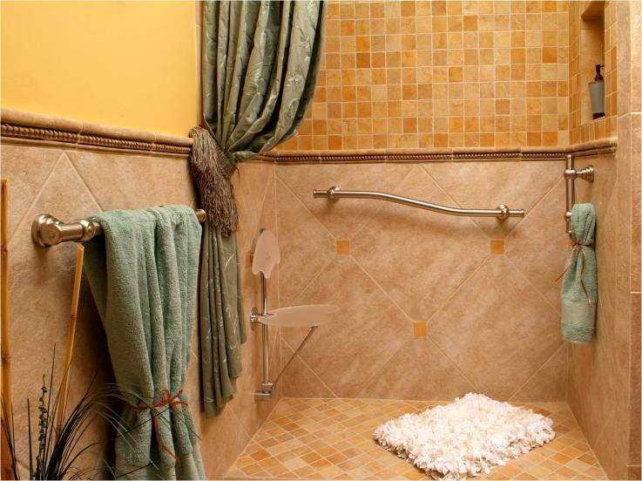
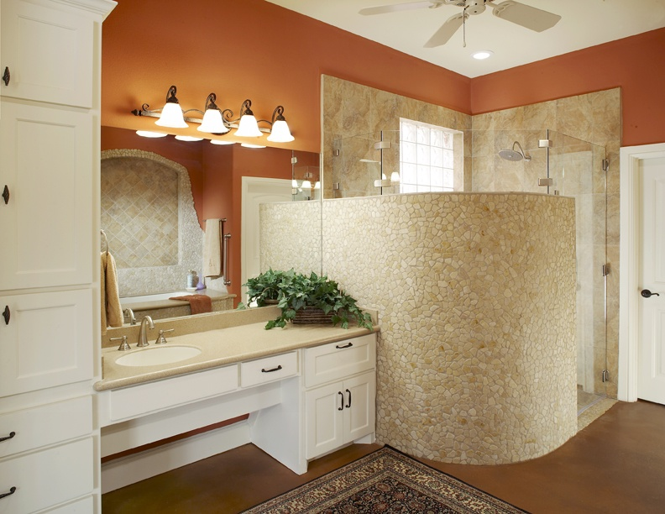
BARRIER-FREE BATHROOMS
Can be stunning!

Slide 11
SHOWER ROOM

Slide 12
FOLD-DOWN SHOWER BENCH
Lixit spout for dog!

Slide 13
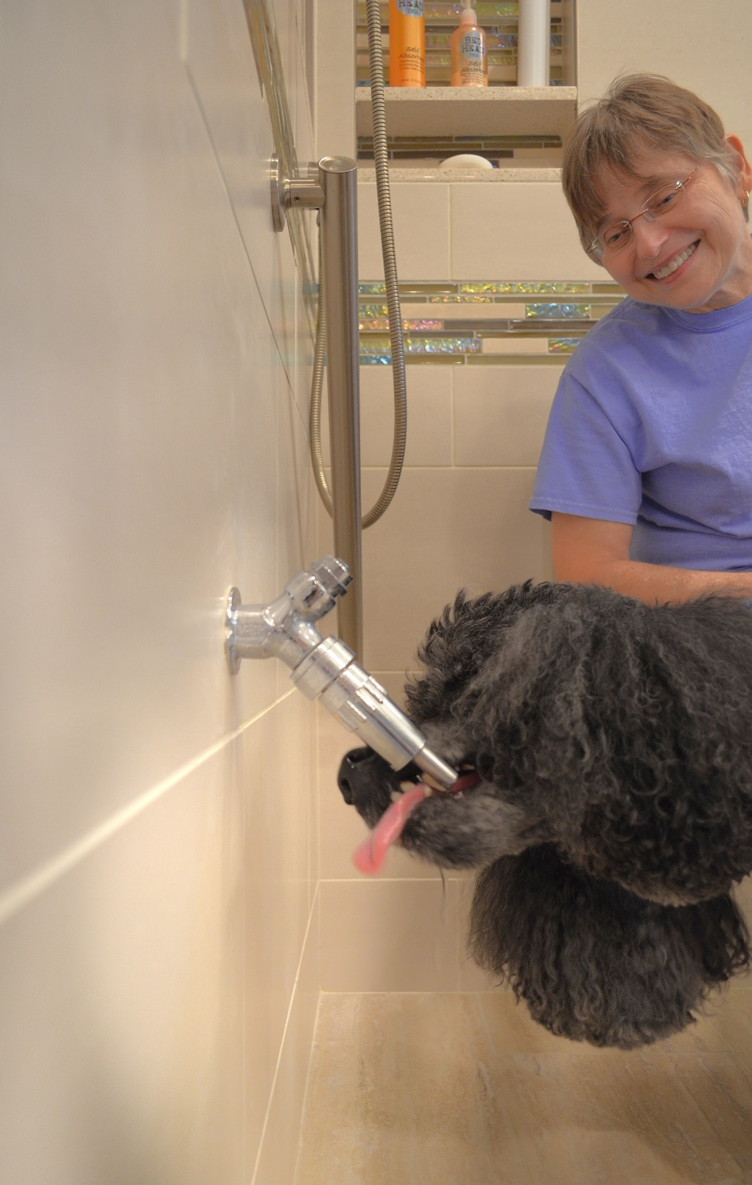

Slide 14
TOILET WITH TANK IN THE WALL

Slide 15
CARD DOOR TUB-SHOWER

Slide 16
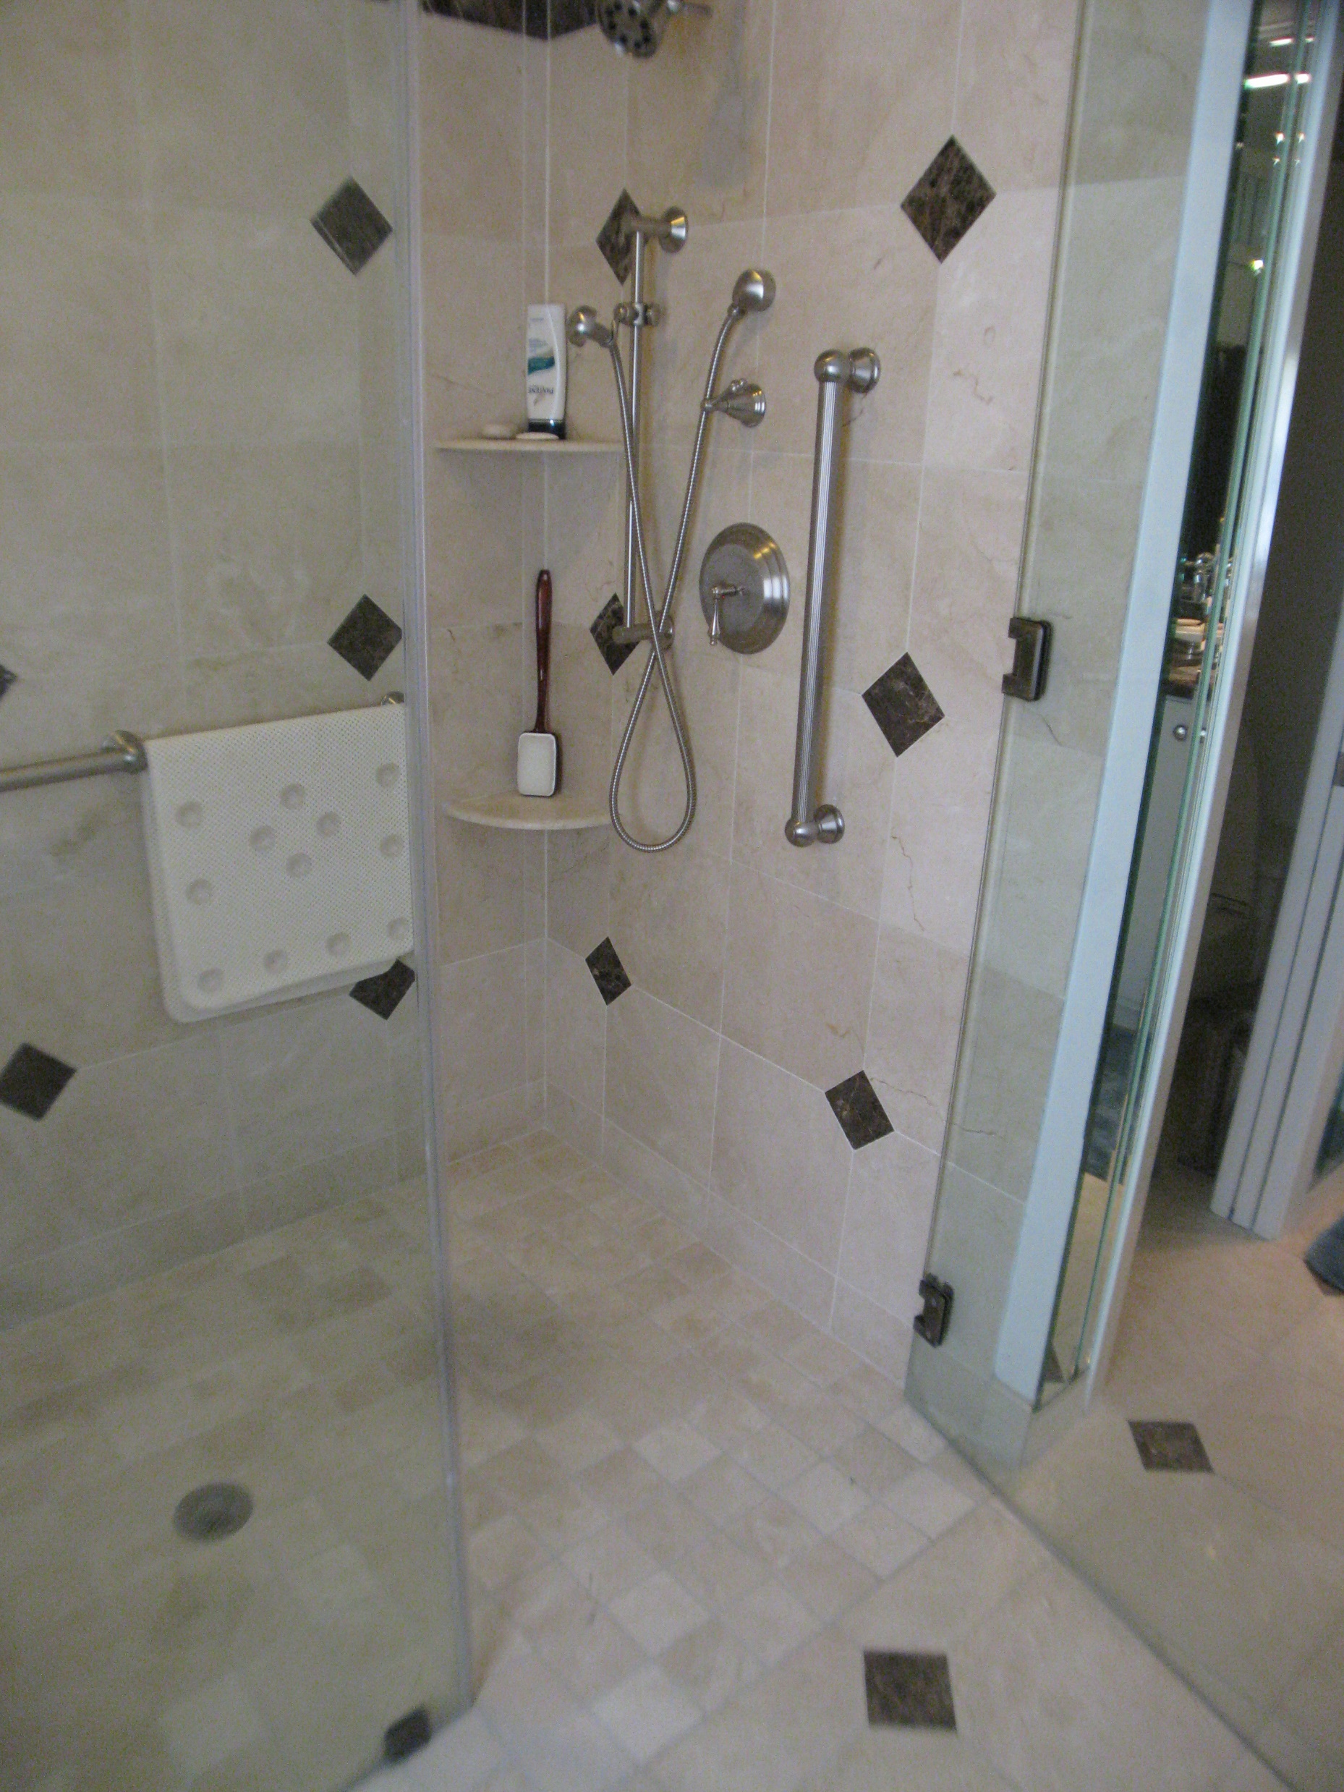
Dangerous !
Much better!

Slide 17
EXAMPLE OF NICE, INTEGRATED RAMPING

Slide 18
SIDE FAUCET

Slide 19
LED-LIT CLOSET RODS

Slide 20
ACCESSIBLE BATH

Slide 21
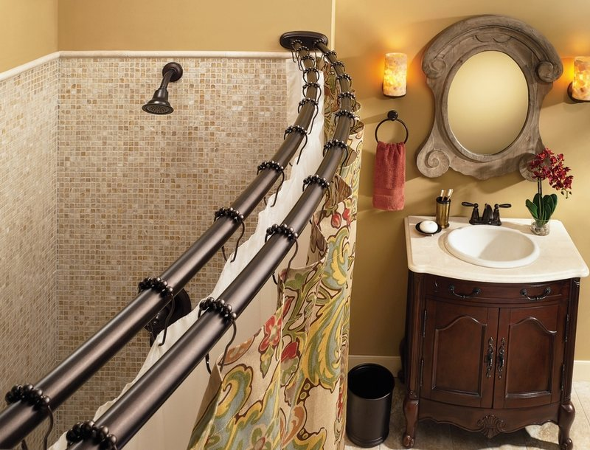
Curved Shower Rod

Slide 22
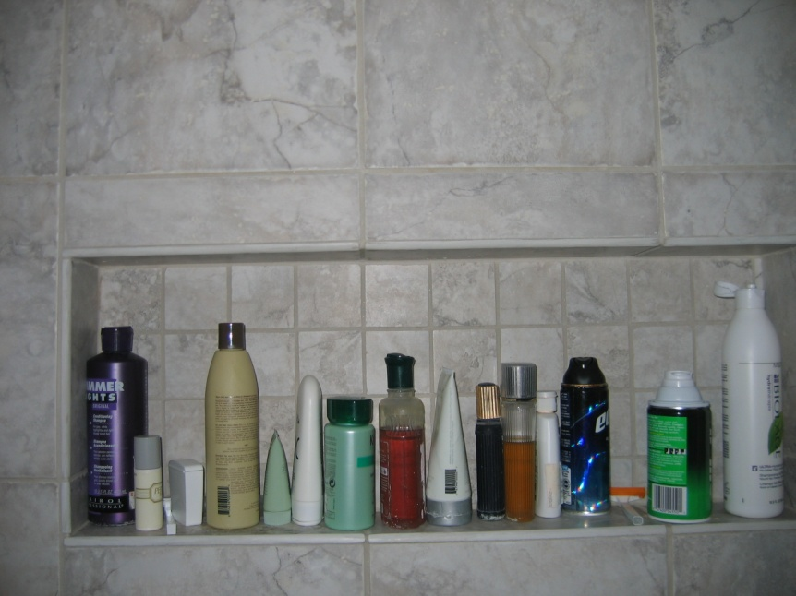
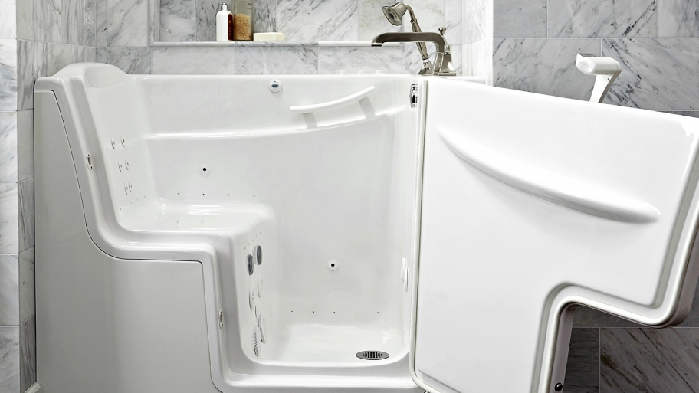
Shampoo box
Car Door Tubs

Slide 23
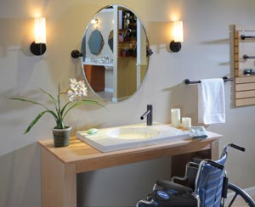
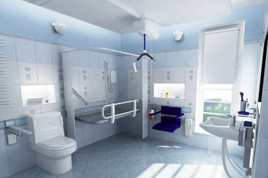
Doing it Contemporary Style

Slide 24
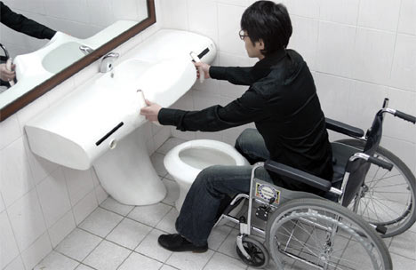
Japanese Universal Design (Yes, that is a toilet)

Slide 25
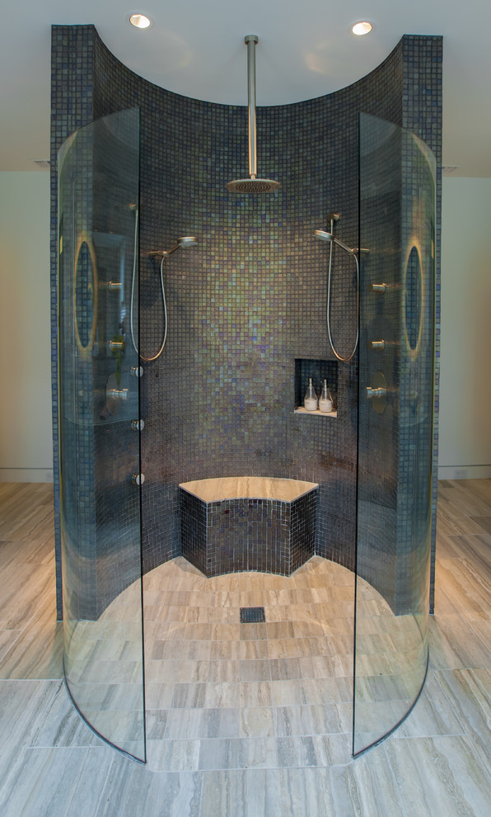

Slide 26
DOUBLE WALK-IN

Slide 27
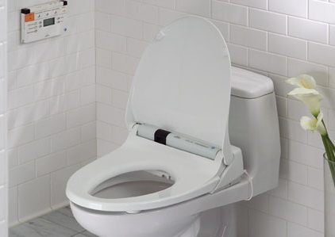
Bidet Toilets Be sure to get the one with WARM water
.

Slide 28
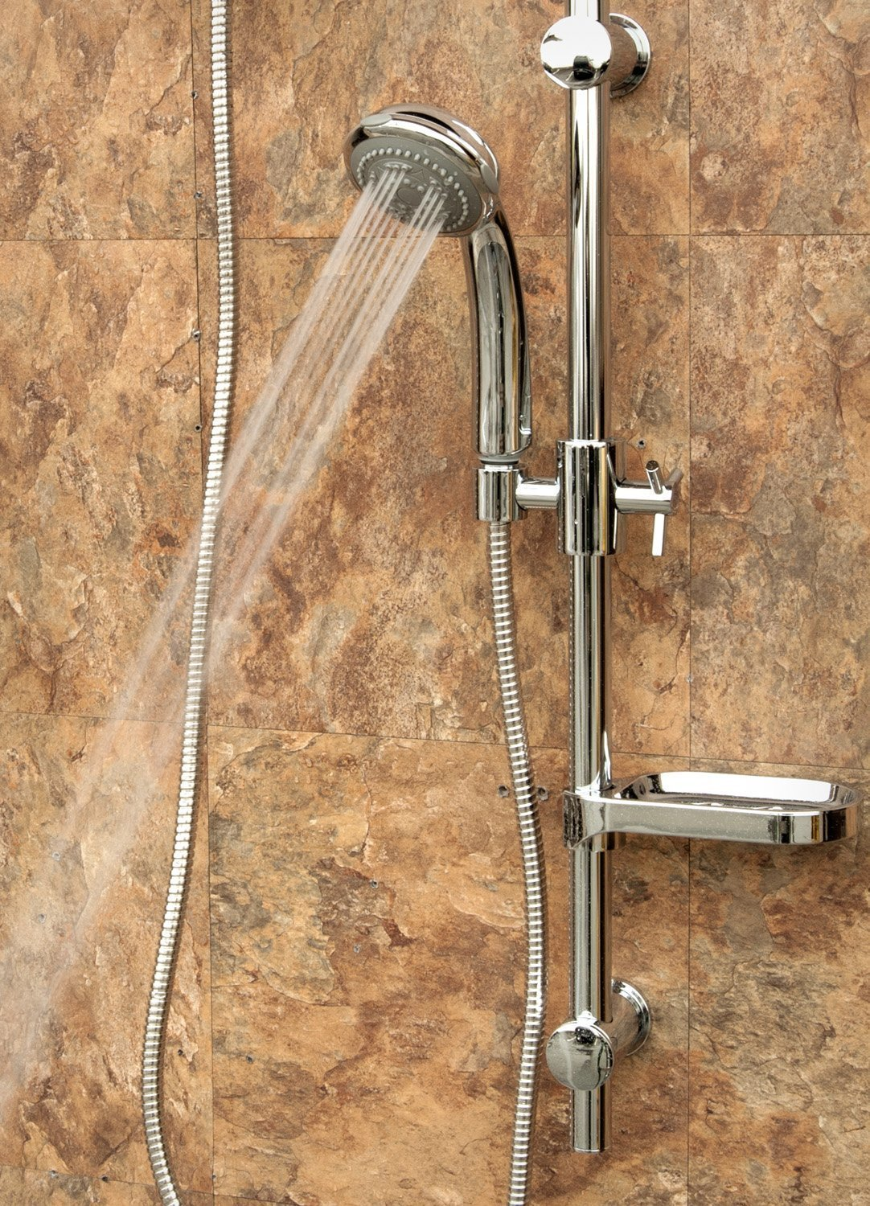
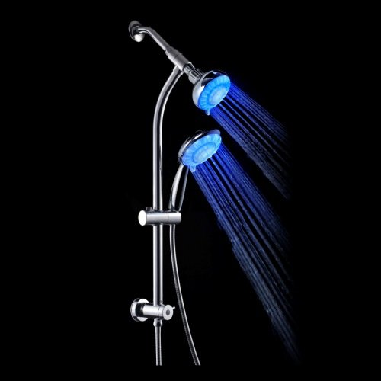

Slide 29
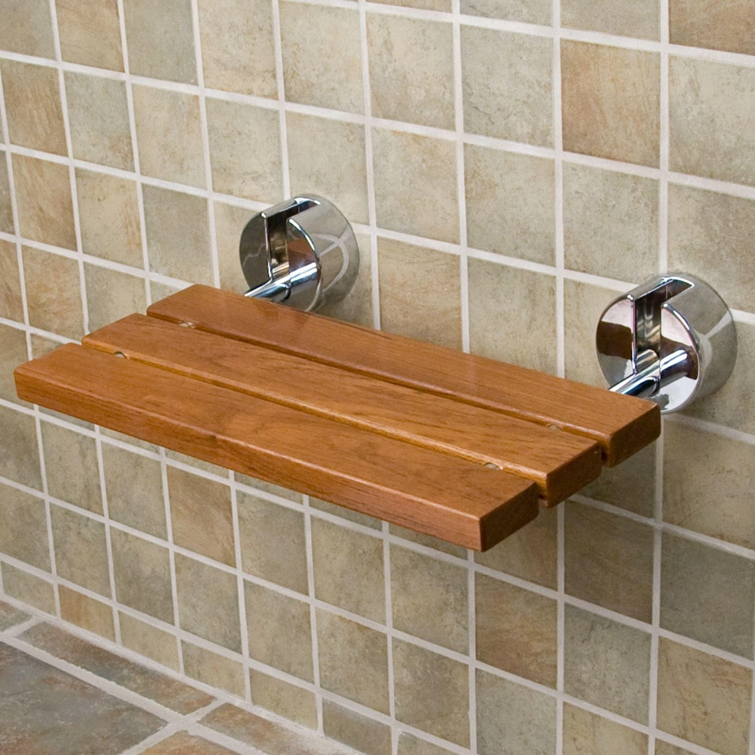
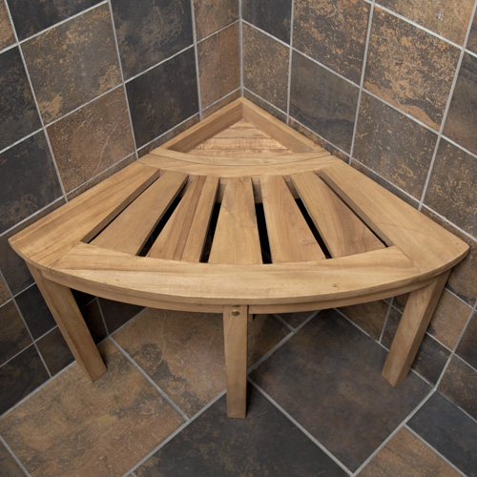

Slide 30
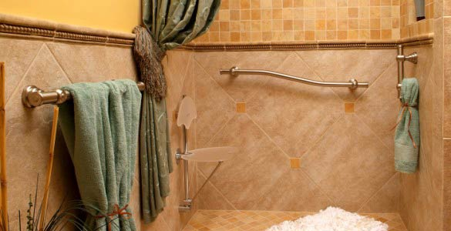
Gorgeous Grab Bars

Slide 31
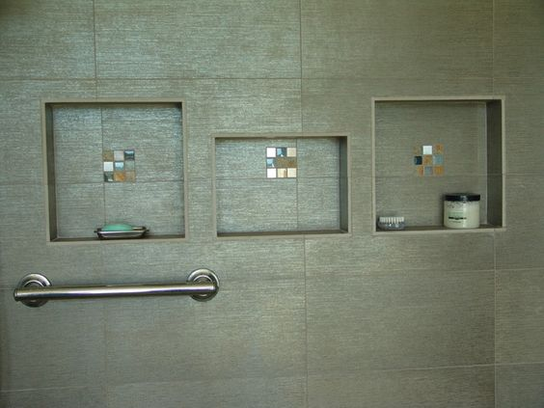
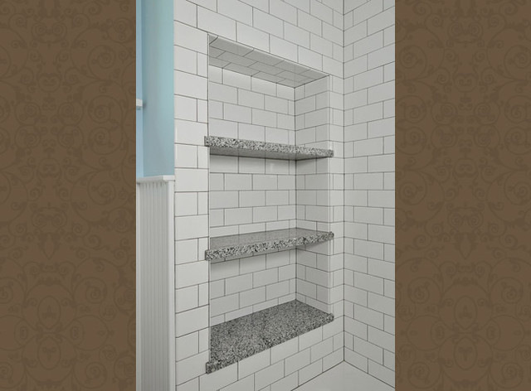
Handy Shampoo Boxes

Slide 32
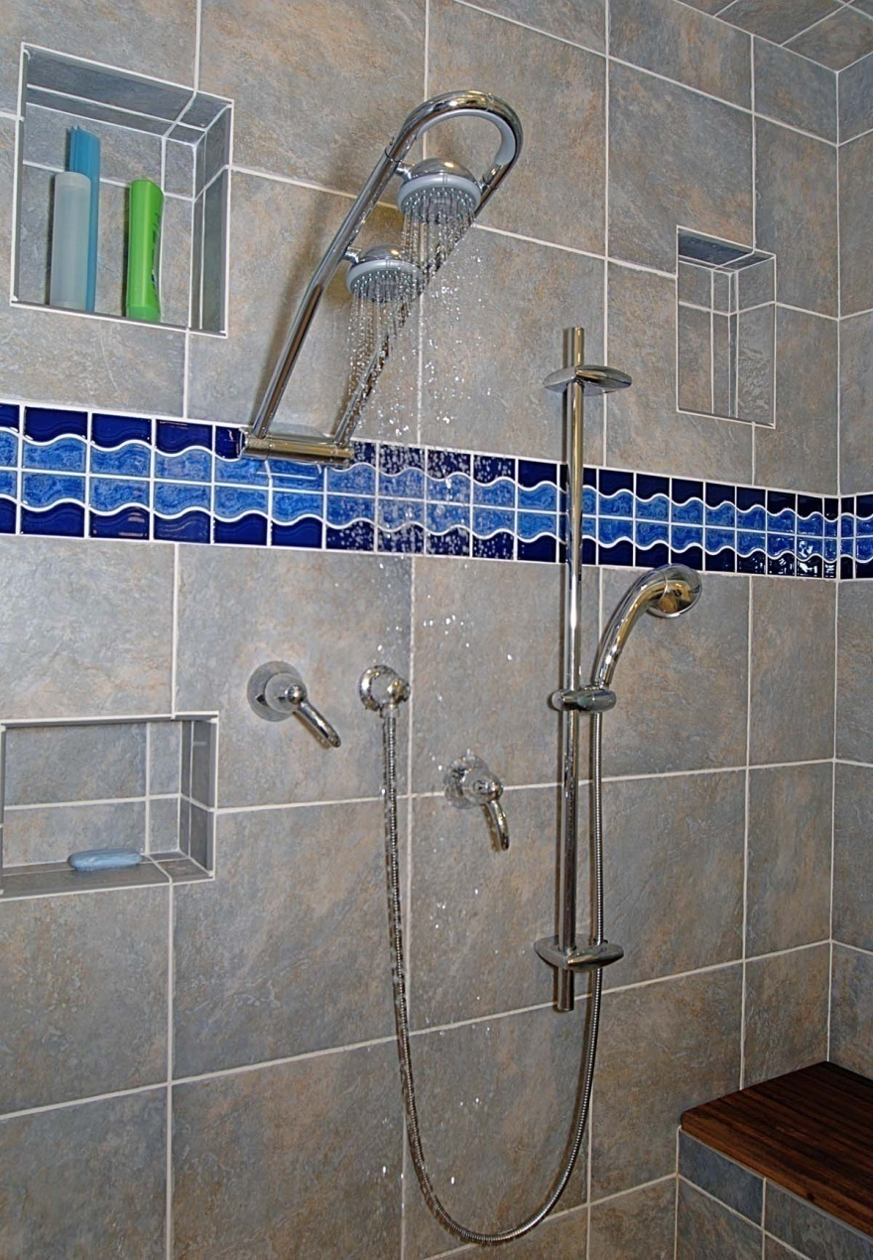
Nice Bath
Hand-held shower head
Teak-topped bench seat
Adjustable water sources
Anti-Scald Fixtures

Slide 33
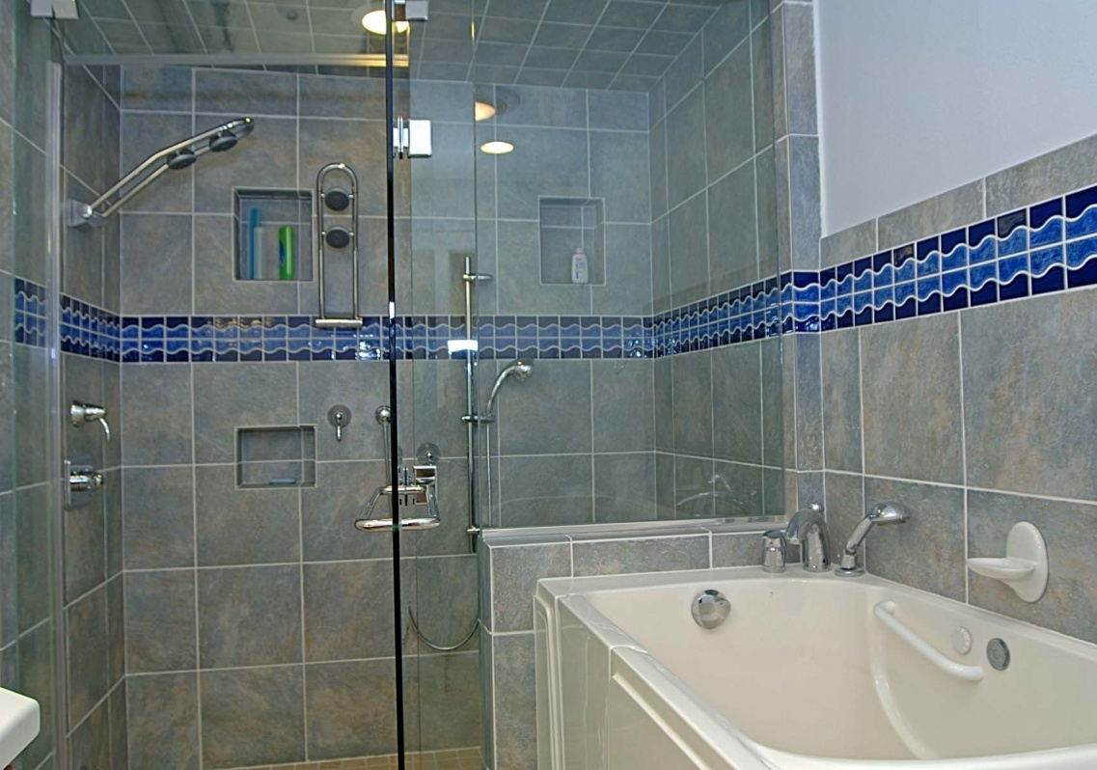
Shower and Walk-in Tub

Slide 34
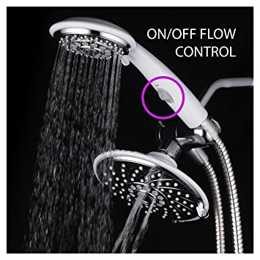
Shower head with “Pause Control”
Push button controls

Slide 35
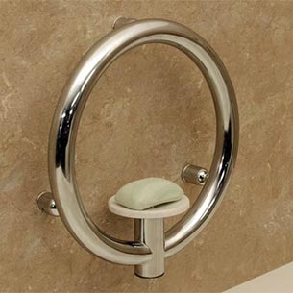
STYLISH “INVISIBLE” BARS

Slide 36
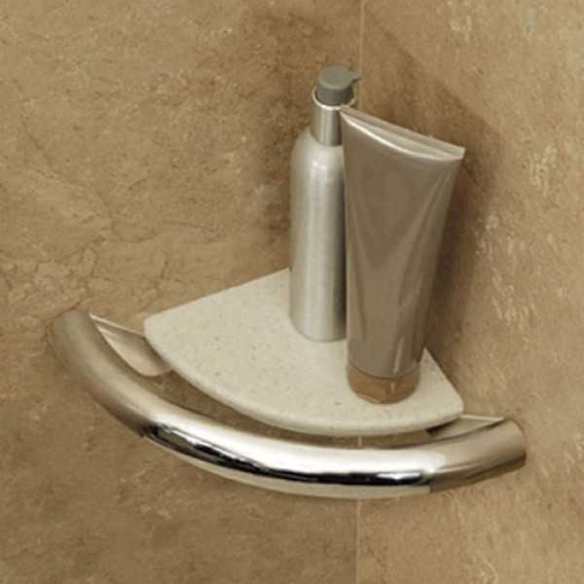
INVISIBLE GRAB RAILS

Slide 37
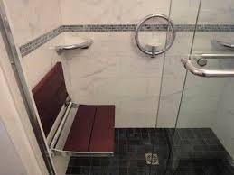
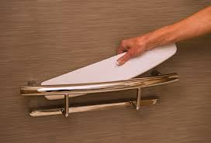

Slide 38
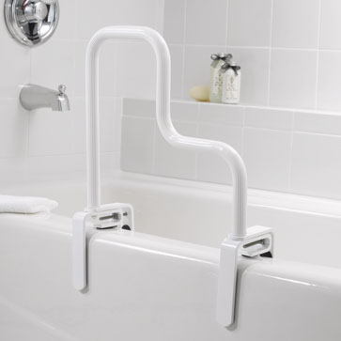
CLAMP-ON RAILS

Slide 39
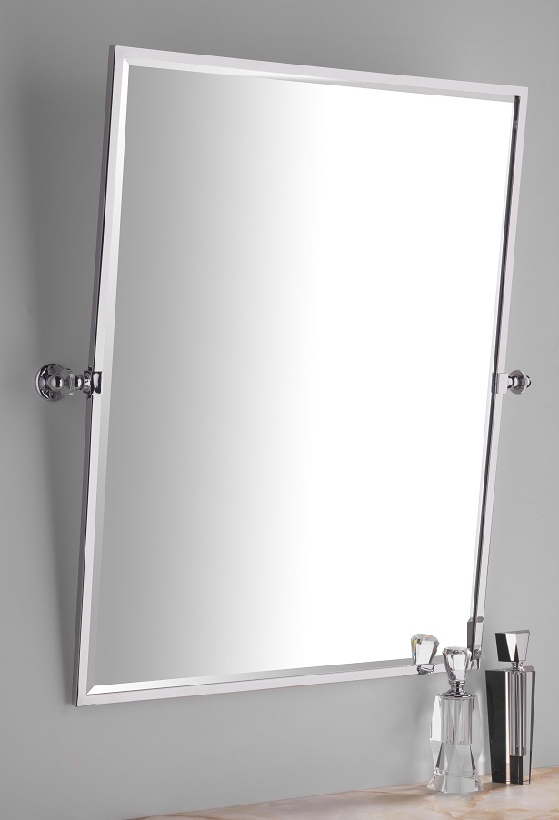
Stylish Tilting Mirrors

Slide 40
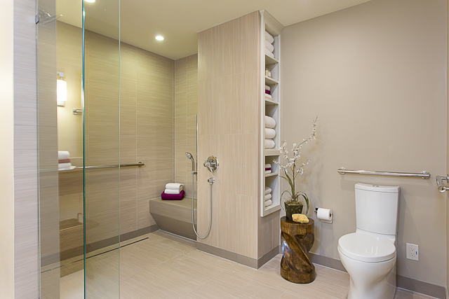
Remodeled bath

Slide 41
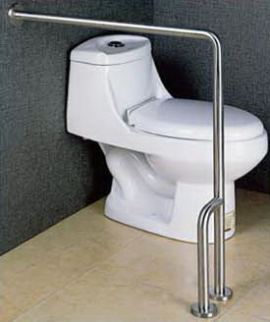
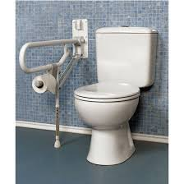
Floor-Mounted & Folding Rails
Notes:
Used where toilets Fi
Not best choice
Find better pics

Slide 42
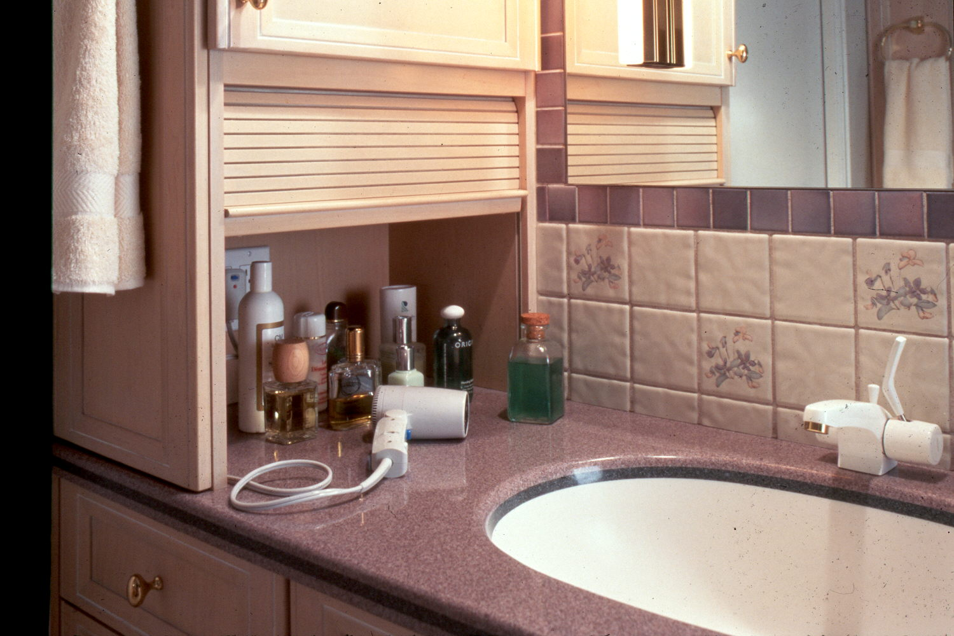
Other Cool Bath Ideas

Slide 43
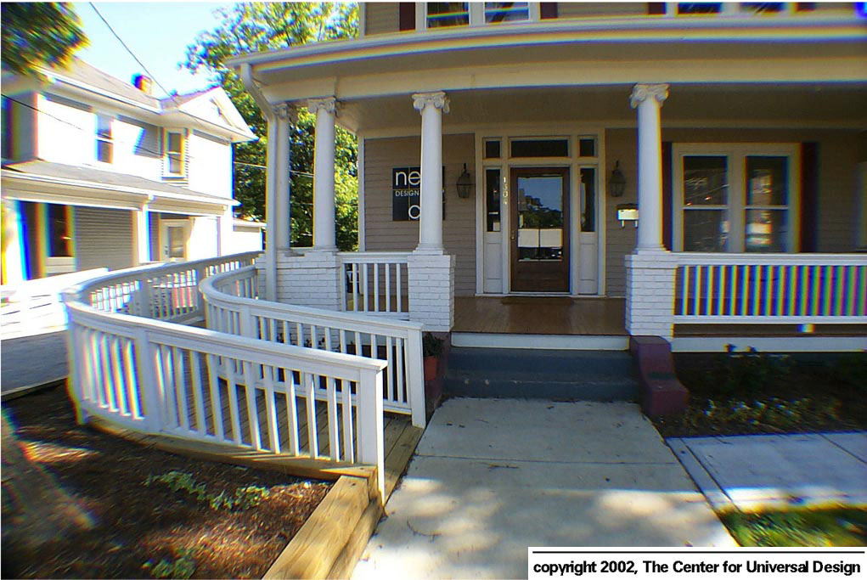
RAMPS – The Good, the Bad and the Ugly

Slide 44
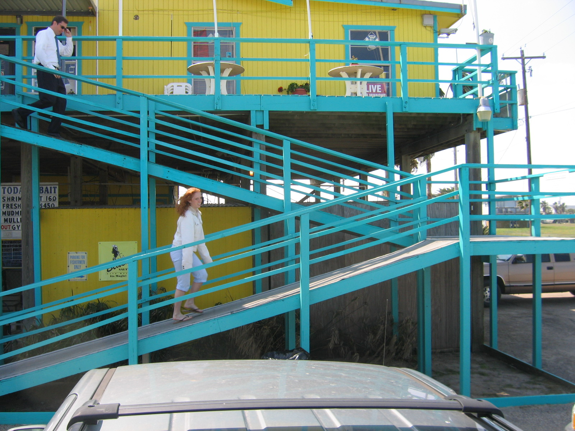
BAD

Slide 45
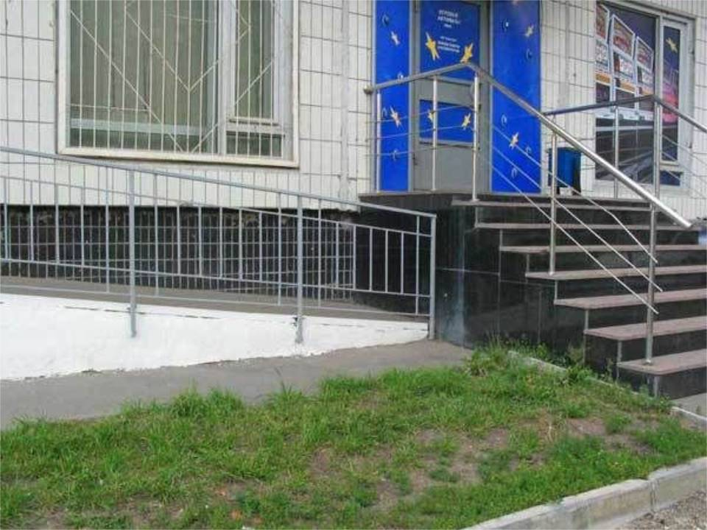
“BADDER”

Slide 46
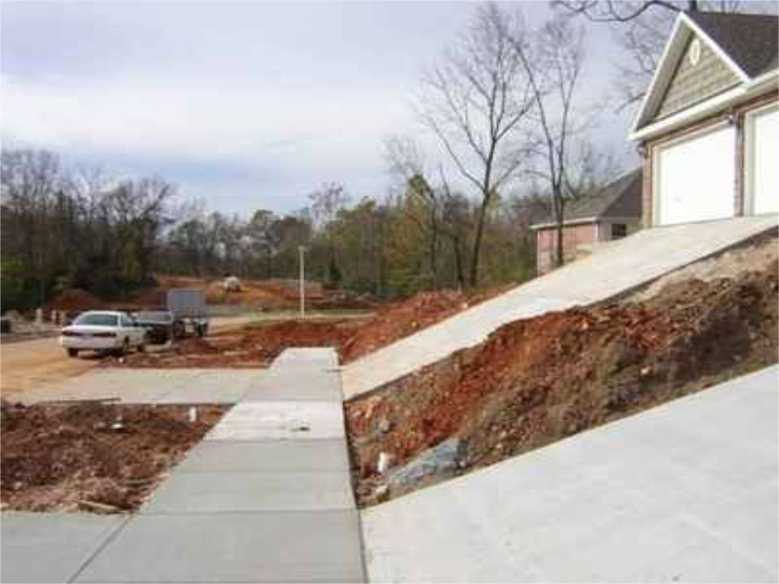
BADDEST In the flood zone perhaps??

Slide 47
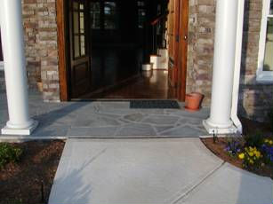
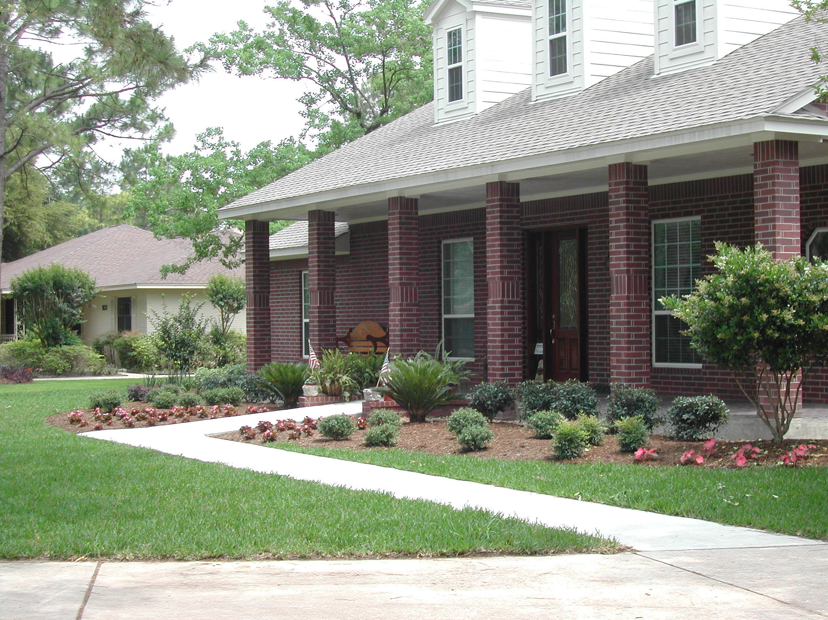
Zero Step
Entry in Houston

Slide 48
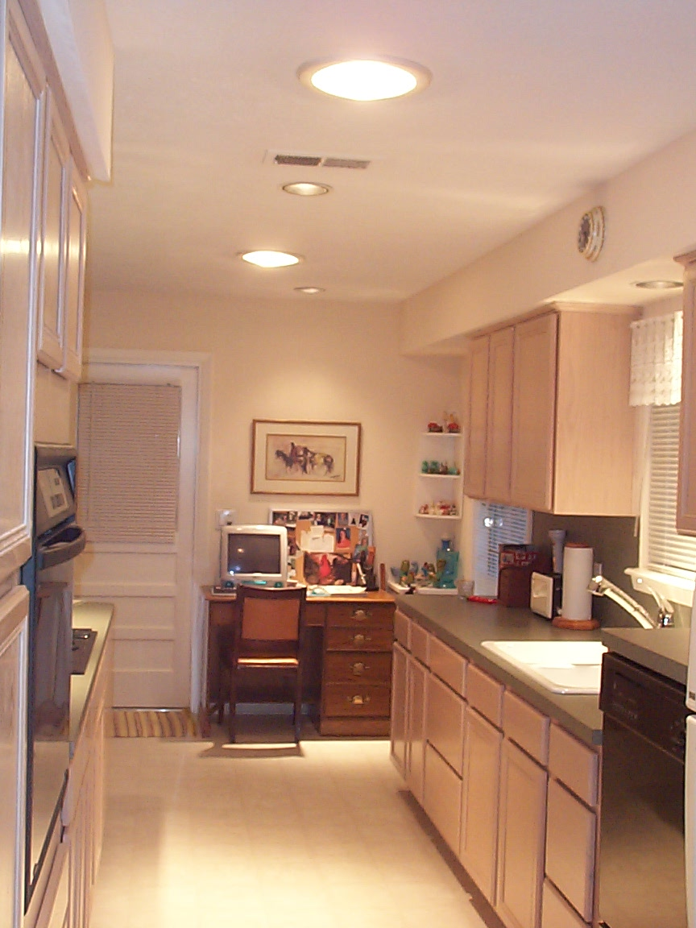
Kitchen Ideas
Note “Sun Tunnels” for lots of natural light
No, they don’t leak
like some skylights
Lots of drawers
are easier to deal with
than cabinets

Slide 49
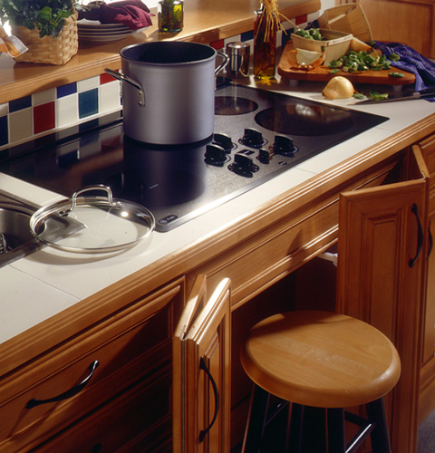
Cooktop with pull-out stool

Slide 50
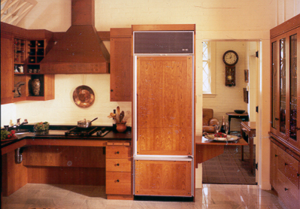
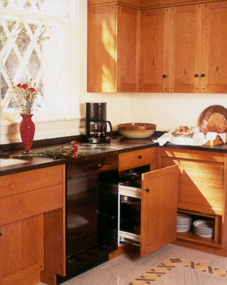
Pull out storage
Knee room under counter

Slide 51
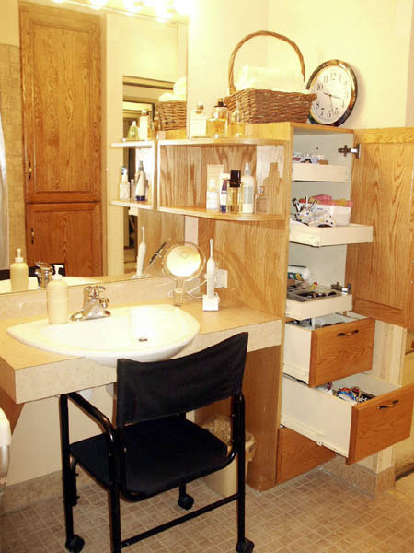
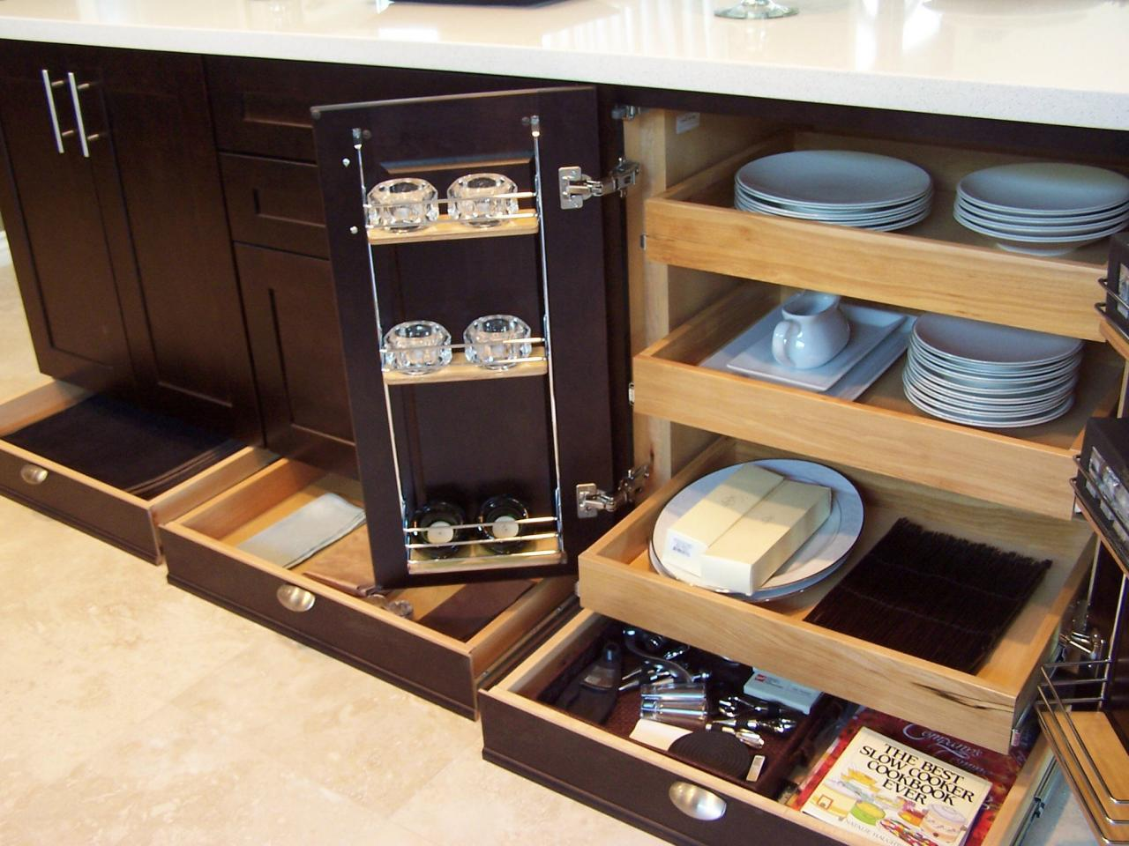
Lots of Low, Pull-out Storage

Slide 52
Lower, crank-type windows

Slide 53
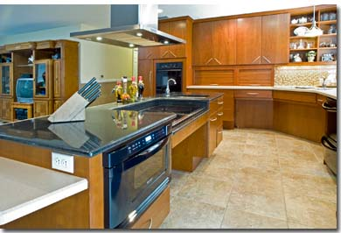
Attractive User-Friendly Kitchen

Slide 54
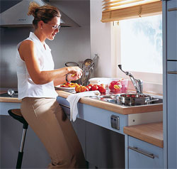
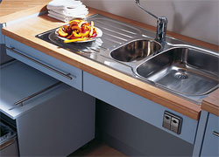
Adjustable Height Sinks
Sink down
Sink up

Slide 55
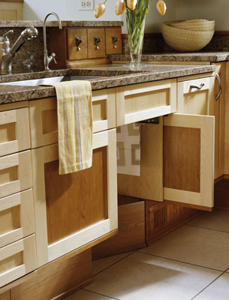
Slide-in doors
Note foot pedals for hot and cold water

Slide 56
Adjustable Cabinets, Shelves and Lifts

Slide 57
Appliance Lift in Action

Slide 58
High Toe kicks, Low Microwave

Slide 59
Side-Open & Fold-Down Doors

Slide 60
Cool Induction Cooktops

Slide 61
Raised Dishwashers with Storage Below

Slide 62
Raised Dishwasher to help your back!
Note drawer
below
Microwave at easy
height

Slide 63
Microwave
Contrasting
colors
High toe kick
Raised Dishwasher
Photo Courtesy of Whirlpool Corporation

Slide 64
Package Shelf by Entry Door
– Very Handy!

Slide 65
Magic! How to Widen a Doorway
Swing-clear Hinges add almost 2 inches!
Save about $1500.00 on the cost of removing and widening the doorway

Slide 66
Exterior Chair lift

Slide 67
Chair Lift
Chair Lift
Notes:
Chair Lift
Lift can be folded away when not being used

Slide 68
Magic! “Look Ma - No Threshold”
Magic! How to do “NO Threshold”
LOOK MA, NO THRESHOLD!
* Nice slate ramp, too!

Slide 69
Here’s How It Works…
There is a black,
spring-activated
rubber strip that
presses down on
the floor when the
door closes, sealing
out the bugs!

Slide 70
Home Elevators
Notes:
When space and funding allow, elevators are added to homes
Has standard door rather than typical elevator door; example of universal design

Slide 71
Front-Loading Machines
Notes:
Get pic of Ann’s (Dan’s Sis) laundry room

Slide 72
Light Switches & Timers
Notes:
Paddle switches should be used when possible
Maximum height of 54” for side reach, 45” for front reach

Slide 73
The Idea Center

Slide 74
THE END!
I HOPE YOU GOT SOME GREAT IDEAS FOR YOUR LIFE
THANK YOU ALL FOR COMING.
For more information email me at: dbawden@legaleaglecontractors.com
…or call my main number at 713-723-8850

